Slide 1
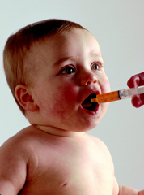
Pediatric Pharmacokinetics
Ina Lee Calligaro, Pharm.D.
Temple University School of Pharmacy

Slide 2

Children Are Not Small Adults
Inmagine.com

Slide 3




Heterogeneous Population
It is easier to harm a child as compared to an adult
More opportunities to make a mistake
Greater opportunity to make an impact!

Slide 4

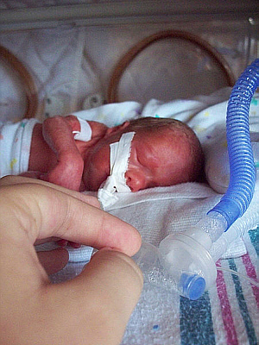


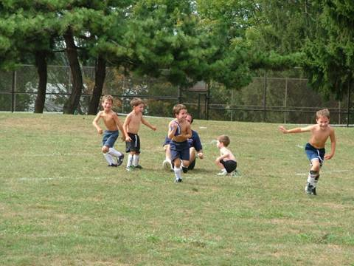

Infant
Newborn
Toddler
Preterm
Adolescent
Child

Slide 5
Special Considerations in Pediatric Patients
Easier to cause harm
Limited data
Unlabeled uses
Lack of available dosage forms
Lack of appropriate concentrations

Slide 6
Pediatric Patients Require Individualized Dosing
Weight/BSA based dosing
DP is a 14 day old infant born at 28 weeks gestational age whose birth weight
was 0.8 kg. JP currently weighs 0.9 kg and is being started on
IV vancomycin 13 mg Q 12 hr
Is this dose correct?
13mg/0.9 kg = 14 mg/kg Q 12 hr

Slide 7
Vancomycin Dosing Guidelines
Neonates Postnatal age ≤7 days:
<1200 g: 15 mg/kg/dose every 24 hours
1200-2000 g: 10-15 mg/kg/dose every 12-18 hours
>2000 g: 10-15 mg/kg/dose every 8-12 hours
Neonates Postnatal age >7 days:
<1200 g: 15 mg/kg/dose every 24 hours
1200-2000 g: 10-15 mg/kg/dose every 8-12 hours
>2000 g: 15-20 mg/kg/dose every 8 hours
Infants >1 month and Children:
10 mg/kg/dose every 6 hours

Slide 8
Never except a dose in ml
Ferrous Sulfate Liquid Dosage Forms
Elixer 220 mg/5ml
Liquid 300 mg/5 ml
Liquid drops 75 mg/1 ml
Suspension drops 75 mg/1.5 ml

Slide 9
Pharmaockinetic/Dynamic Changes =
Developmental Pharmacology

Slide 10
Definitions
Gestational Age
Chronological Age
Postmenstrual Age
Corrected Age

Slide 11
Postmenstrual Age = GA+PNA
You receive a prescription for gentamicin for an infant who is 2 weeks old the dose will be different if the child was born full term at 40 weeks GA versus preterm at 26 weeks.
PMA = 42 weeks vs 28 weeks

Slide 12
Absorption
Gastric pH
Gastric motility

Slide 13
Organ Size
Organ weight (%) Neonate Adult
Muscle 25 40
Heart 0.5 0.4
Liver 5 2
Brain 12 2

Slide 14
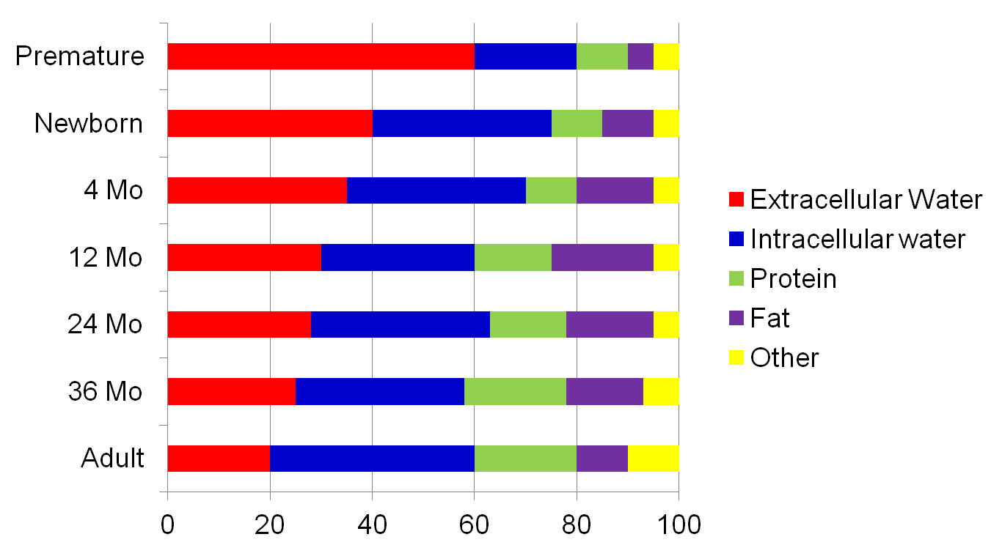
Body Composition
Infants- Toddlers- Adults

Slide 15
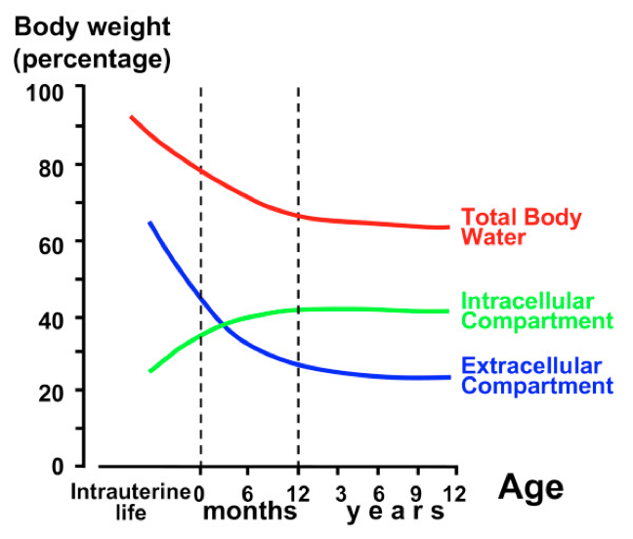
Distribution – Body Water
TBW
Newborn - 80%
Adult – 60%
Bianchetti et.al. Italian Journal of Pediatrics 2009.35:36.

Slide 16

Distribution: Protein Binding
Decreased albumin and alpha₁-glycoprotien
Decreased affinity of fetal albumin to bind drugs
Displacement of bilirubin by highly protein bound drugs and free fatty acids
Notes:
Discuss concern with using ceftriaxone and parenteral fat in newborns with high bili. Also there will be more unbound drug circulating. This is important clinically for highly protein bound drugs like phenytoin. The therapeutic range for phenytoin for children and adults is 10-20 mcg/ml. In newborns the therapeutic range is 6-15 mcg/ml since there will be more unbound drug increasing the therapeutic or potentially toxic effects of phenytoin.

Slide 17
Volume of Distribution
Age | Theophylline (L/kg) | Gentamicin (L/kg) | Diazepam (L/kg)
Neonate | 0.69 (0.19-1.0) | 0.4-0.7 | 1.8-2.1
Infants | 0.45 0.16-0.83 | 0.28
Children | 0.45 | 0.28
Adults | 0.45 | 0.2-0.3 | 1.6-3.2
Notes:
We discussed that newborns and young infants have more total body water especially ECW and less total body fat. Therefore hydrophilic medications will have a larger volume of distribution. This is evident when you look at the volume of distribution of theophylline which is a water soluble drug and has a larger volume of distribution in neonates as compared to infants, children and adults. Gentamicin also has a larger volume of distribution in neonates as compared to infants, children and adults. Note that diazepam which is fat soluble has a volume of distribution similar to adults even though this is a lipophilic drug. it theoretically could
be expected that lipophilic drugs would show a lower Vd in infants and young children; however, this is largely not observed, because these drugs tend to freely associate with cellular components in tissues other than adipose. The failure to observe a lower Vd for lipophilic agents in young children may also indicate that additional tissue retention mechanisms compensate for the changes in body composition.

Slide 18
Pharmacokinetic Implication of altered Vd
LD = Vd X Cp
F X S
Vd = Volume of distribution
Cp = Desired plasma concentration
F = Fraction absorbed (bioavailability)
S = Salt
Notes:
If the Vd is increased for a medication you will have to give a larger dose in order to achieve a therapeutic concentration. This is why the dose of some medications are higher on mg/kg basis in neonates and infants as compared to older children and adults.

Slide 19
Effect of Change in Volume of Distribution on Dosing
Drug | Infant Dose | Adult Dose
Gentamicin | 2.5 mg/kg Q 8 h | 1-2 mg/kg Q 8 h
Lasix | 1-2 mg/kg/dose IV | 20-40 mg IV (0.3-0.6 mg/kg for an average size adult)

Slide 20
Hepatic Metabolism
Phase I Phase II
Hydrolysis Glucuronidation
Oxidation Sulfation
Reduction Acetylation
CYP450’s
UGTs
N-acetyltransferase (NAT)

Slide 21
CYP Isoenzyme Activity
All CYP enzymes have decreased activity in neonates except CYP3A7 which is present in utero
Positive correlation between enzyme activity and gestational age

Slide 22
CYP Isoenzyme Activity in Children
Increased Activity
  CYP1A2, CYP2C9, CYP3A4
Similar to Adult Activity
  CYP2C19, CYP2D6
CYP 2B6
  Increased clearance of gabapentin in adolescents
Notes:
Cyp1a2 is higher → metabolizes caffeine and theophylline

Slide 23
Phase II Metabolism: Neonates and Infants
Decreased glucuronidation due to decrease UGT
Similar ability to sulfate medications
Notes:
Decrease in UGT – unable to break down (glucuronidate) billirubin = increase bilirubin

Slide 24
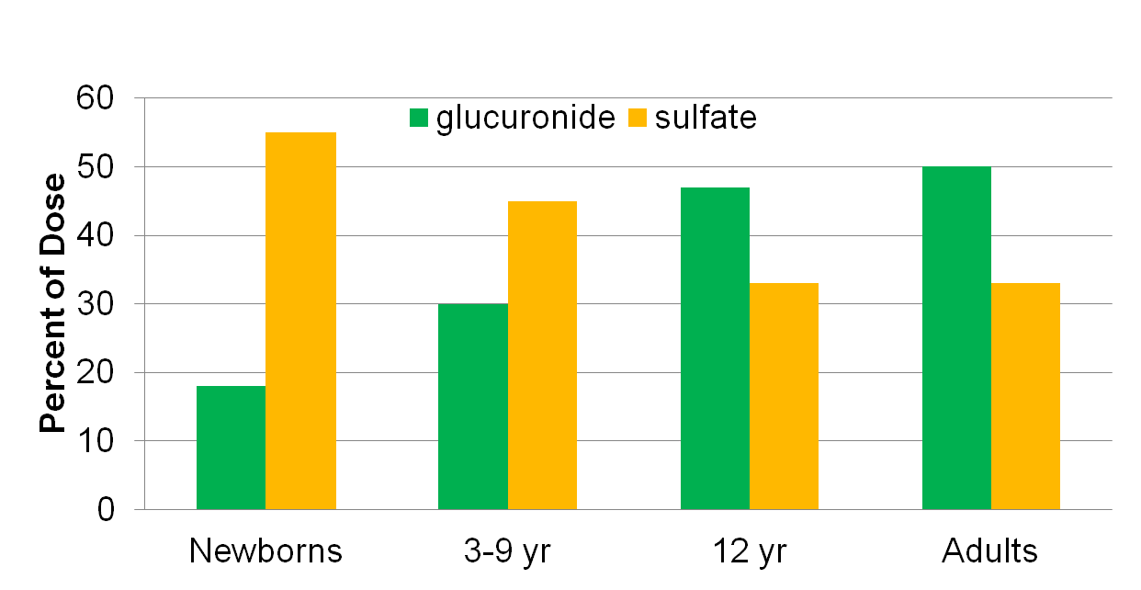
Metabolism of Acetaminophen
Notes:
Same rate in metabolizing APAP
Newborns = High Sulfate + low glucuronide
Adults = low Sulfate + high glucuronide

Slide 25
Examples of altered metabolism
Theophylline
Acetaminophen
Bilirubin
Chloramphenicol
Morphine
Benzyl alcohol

Slide 26
Renal Function: GFR
GFR is affected by GA, BW, and postnatal age
At birth GFR is 50% of adult values
Increase in 1st week
Doubles by 6 weeks
Doubles again by 6 months
Adult values achieved at about 1 year

Slide 27
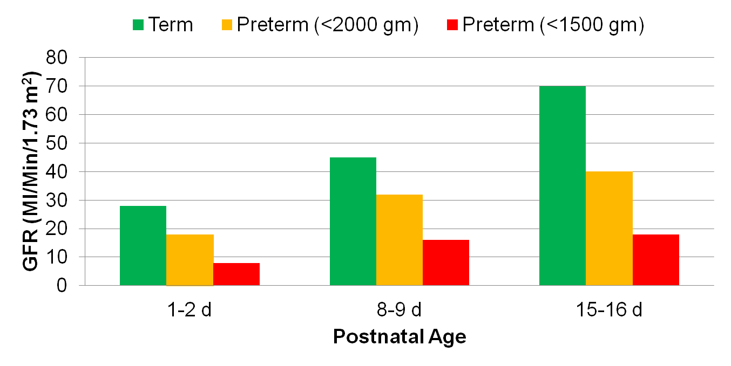
Renal Filtration/Age

Slide 28
Development of Renal Function in Children
Tubular Secretion
Tubular Reabsorption

Slide 29
Assessing Renal Function in Children
In neonates- monitor urine output.
Calculating CrCl – use the Schwartz equation

Slide 30
Gentamicin Dosing Guideline (prior to the use of daily dosing regimens)
Age (weeks) | Weight (g) | Dose (mg/kg) | Interval (h)
PNA 0-4 | < 1200 | 2.5 | 18-24
PNA < 7 days | Greater than or equal to 1200 | 2.5 | 12
PNA > 7 days | 1200 – 2000 | 2.5 | 8-12
PNA > 7 days | Greater than or equal to 2000 | 2.5 | 8

Slide 31

Photograph by Anne Geddes

